Slide 1
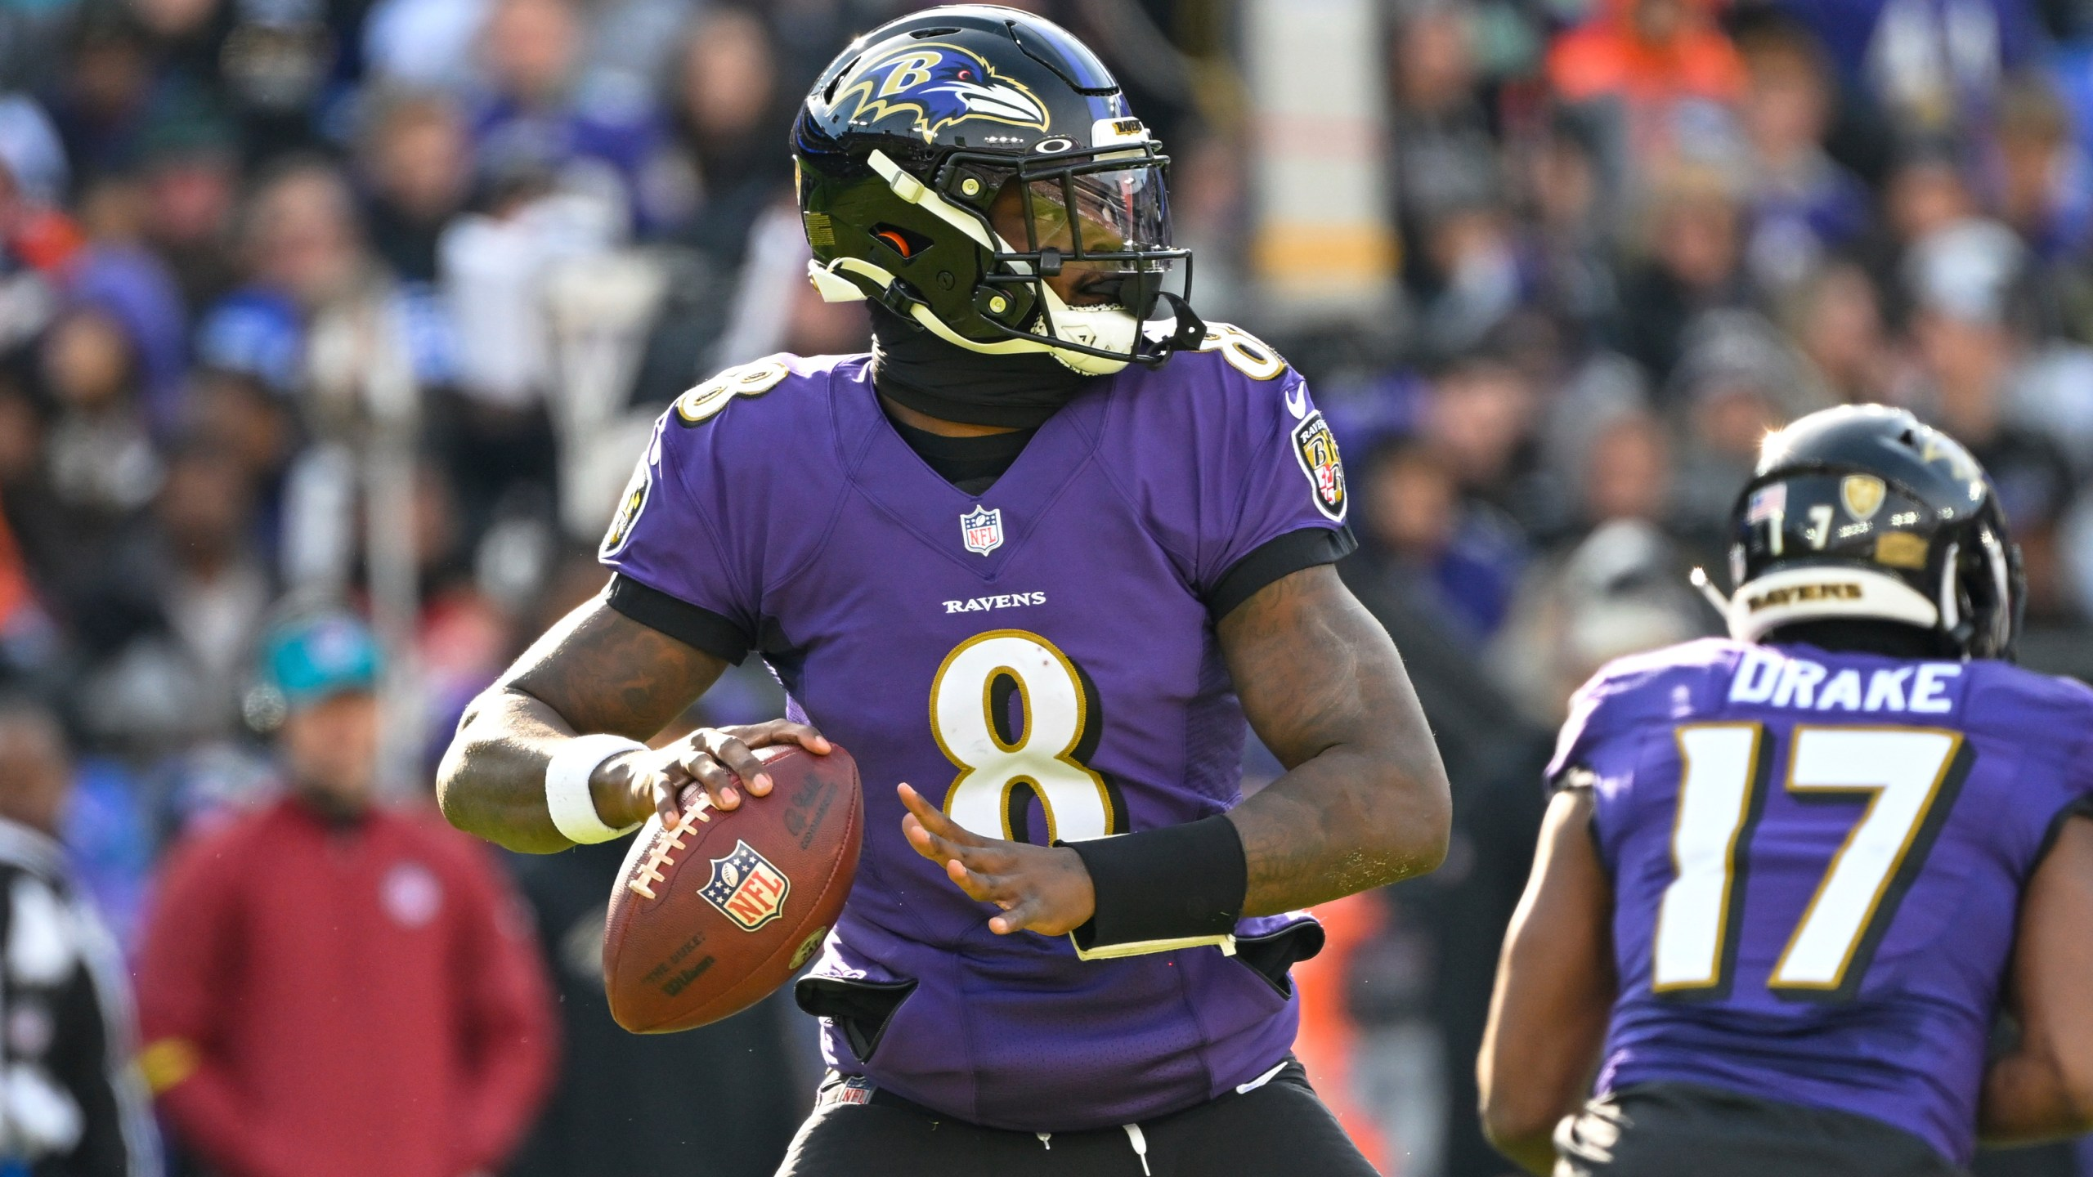
Regression Analysis: NFL Games & Offensive Points Scored
Adem Khelifi & Patrick Haynes
This Photo by Unknown Autho is licensed under CC BY-NC-ND

Slide 2

Overview OF Dataset & Dependent Variable
The dataset provides predictors from 100 sampled NFL games
Contains both ratio data (e.g., rushing and passing yards) and categorical data (e.g., home-field advantage) with dummy variables
Dependent Variable: Offensive Points Scored
-

Slide 3
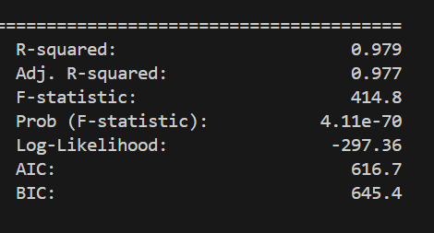
Summary of Regression Model
Model Significance
Prob (F-Statistic) = 4.11e-70 < 0.05
The model is significant

Slide 4
R-Squared & Adjusted R-Squared
R-Squared Value = 0.979
Adjusted R-Squared Value = 0.977
For both values, the dataset accounts for approximately 97% of the variance in the model
The similarity between the two values indicates that all the predictors increase the fit of the model, with no overfitting

Slide 5
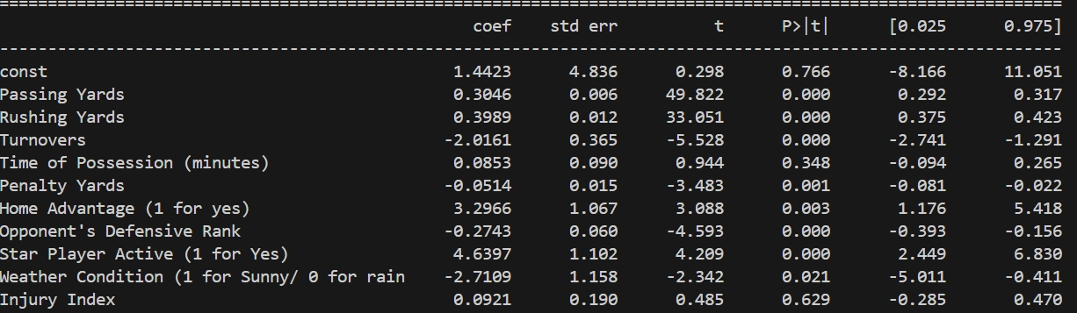
Summary Continued: Independent Variables
Significant Variables
Passing Yards, Rushing Yards, Turnovers, Penalty Yards, Home Advantage, Opponent Defensive Rank, Star Player Active
All contain p-values less than 0.05
Insignificant Variables
Time of Possession (p-value of 0.348), Injury Index (p-value of 0.629)
All contain p-values greater than 0.05

Slide 6
Significant Predictors
For Offensive Points Scored:
Star Player Active (Binomial): 4.639 coefficient value
Home Advantage (Binomial): 3.296 coefficient value
Against Offensive Points Scored:
Turnovers: -2.016 coefficient value
Weather Conditions: (0 for Rain, 1 for Sunny): -2.710 coefficient value
Weather Conditions should be removed because a sunny game would not yield 2.7 fewer offensive points than a rainy game

Slide 7
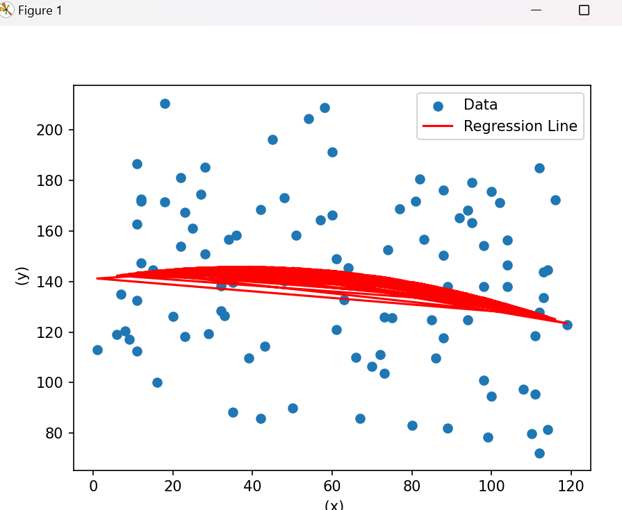
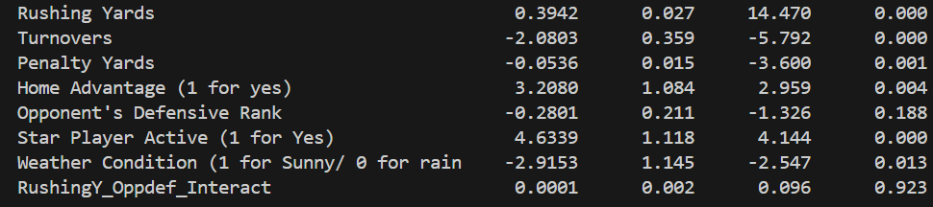
Interaction terms & Nonlinearity
No significant interaction terms
For example, this output shows a significance value of .923 between Rushing Yards and Opponent Defensive Rank
Too insignificant to be assessed
Penalty Yards & Offensive Points Scored
Wide negative parabolic shape
Teams with 0 penalty yards produce approximately 140 yards of offense
The model reaches apex at 60 penalty yards
After 60 penalty yards, the offensive output will be negatively affected by penalties

Slide 8
Conclusions Of The Regression Analysis
Players
Value quality drives and turnover-free football because turnovers are the greatest predictor against offensive points scored
Coaches, Offensive Coordinators, & Athletic Training Staff
Prioritize the health of the star player, as it is the most significant predictor for a team’s offensive points scored
Focus on getting high seeds and home playoff games; instead of resting starters late in the season, work for a higher seed because home-field advantage is the 2nd greatest predictor for offensive points scored

